Slide 1

Single Pulse
Dados e Gráficos

Slide 2
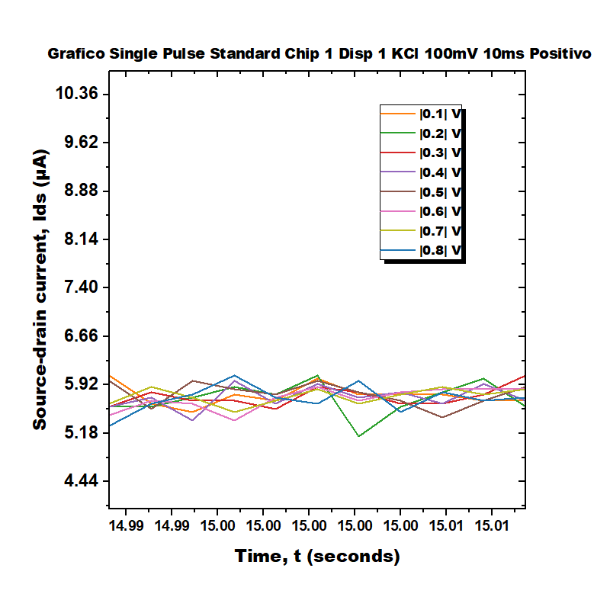
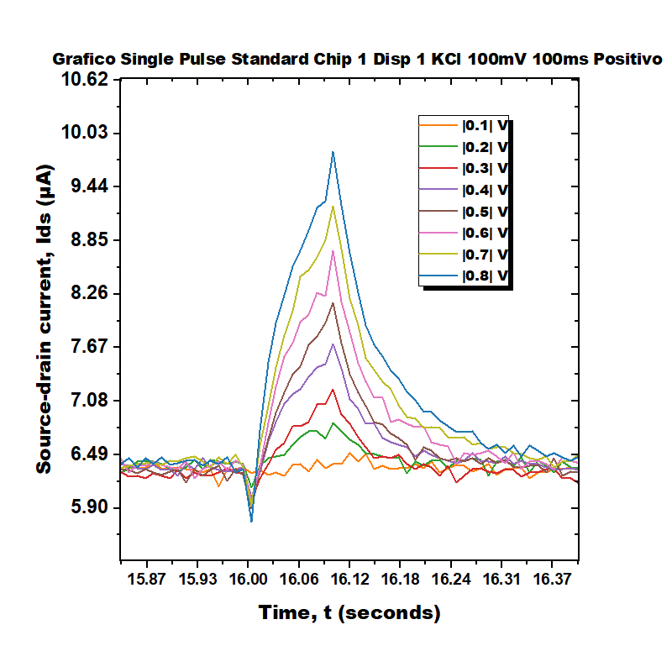
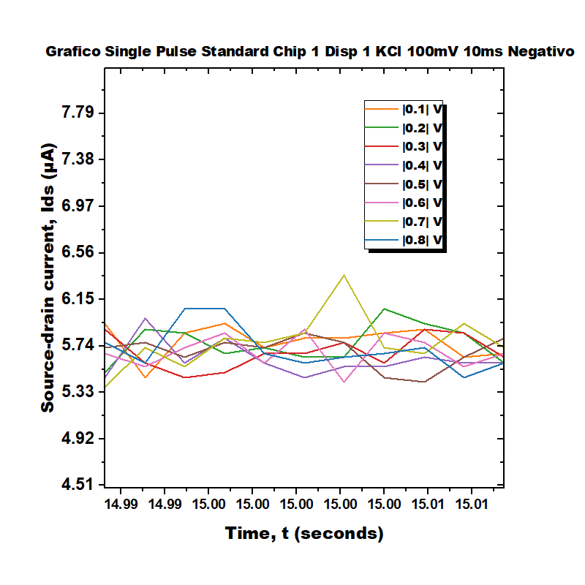
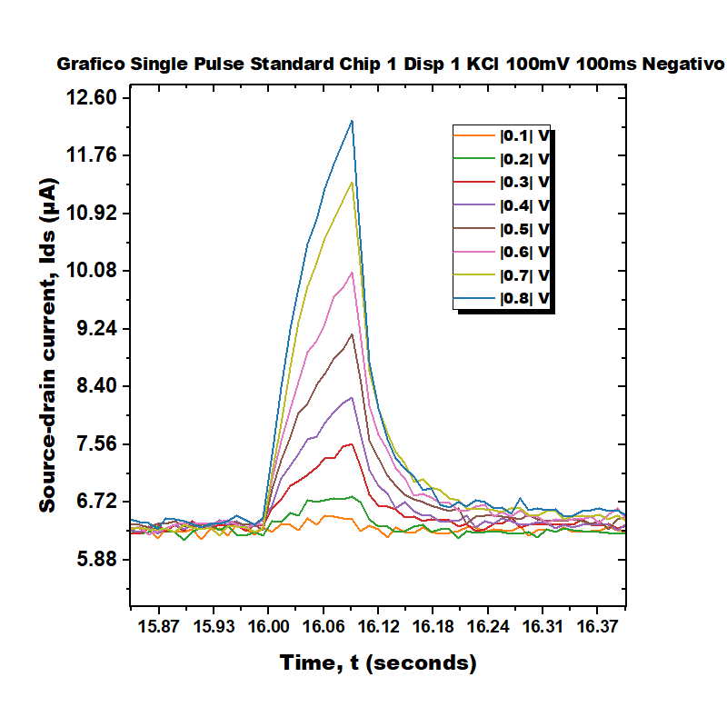
Single Pulse Standard Chip 1 Disp 1 KCl 100mV

Slide 3
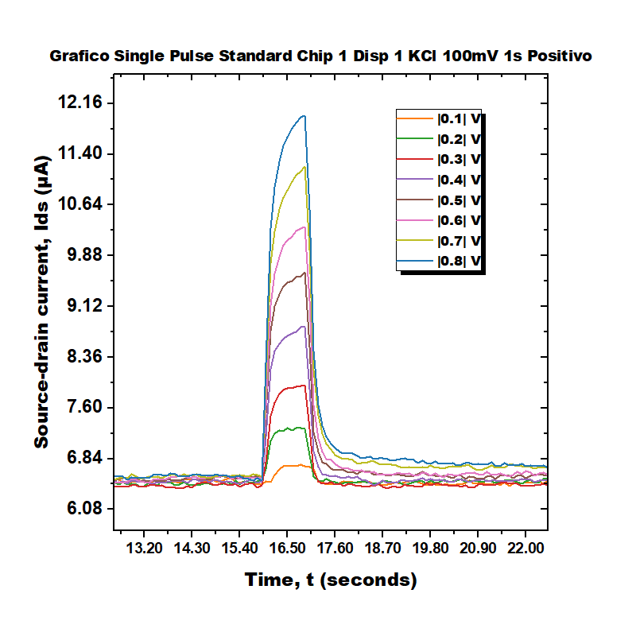
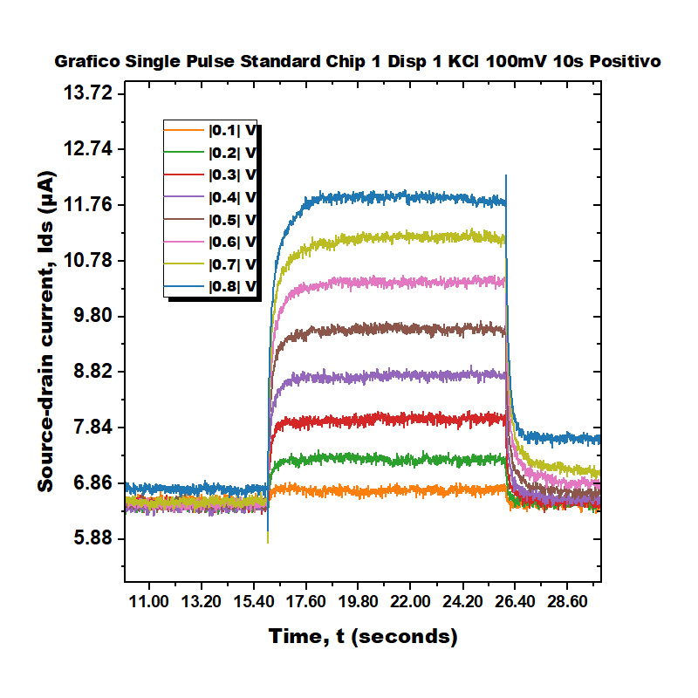
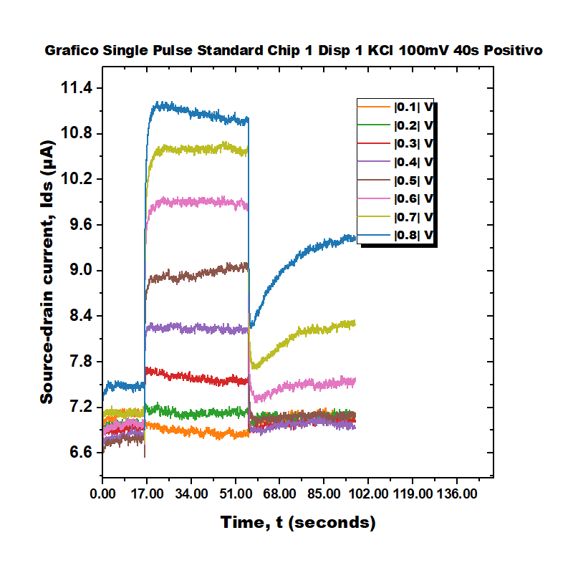
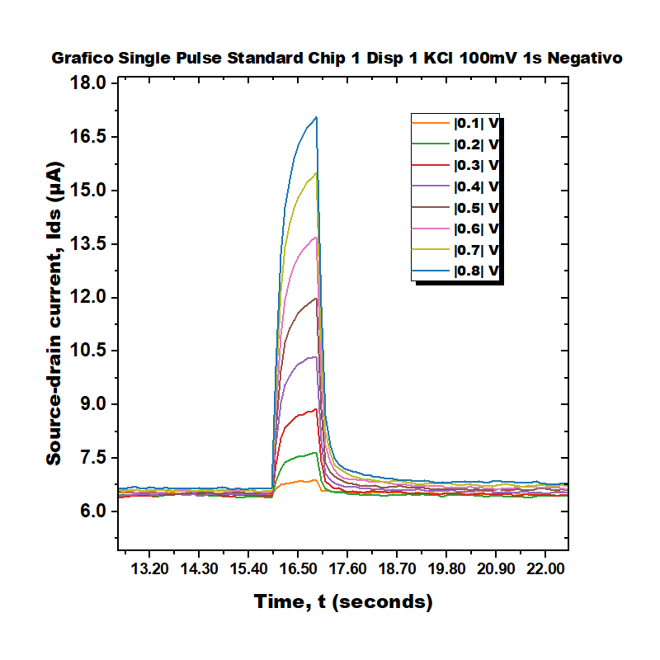
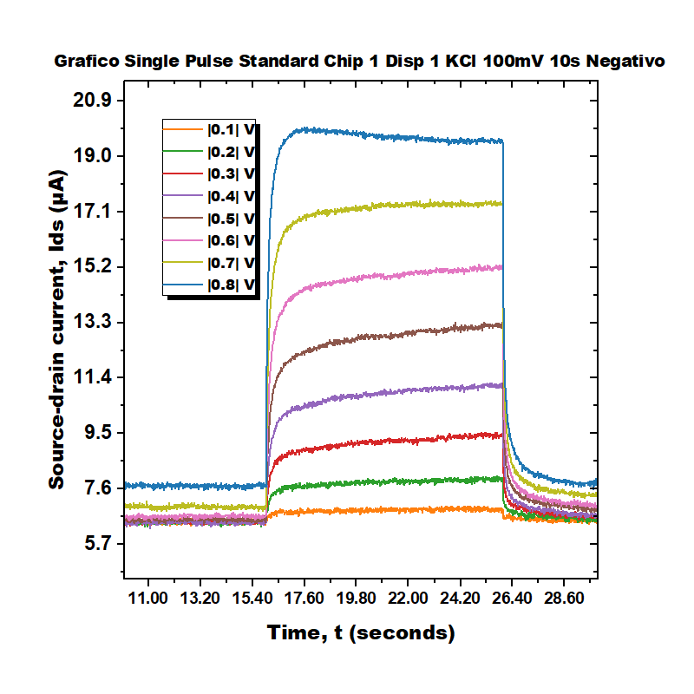
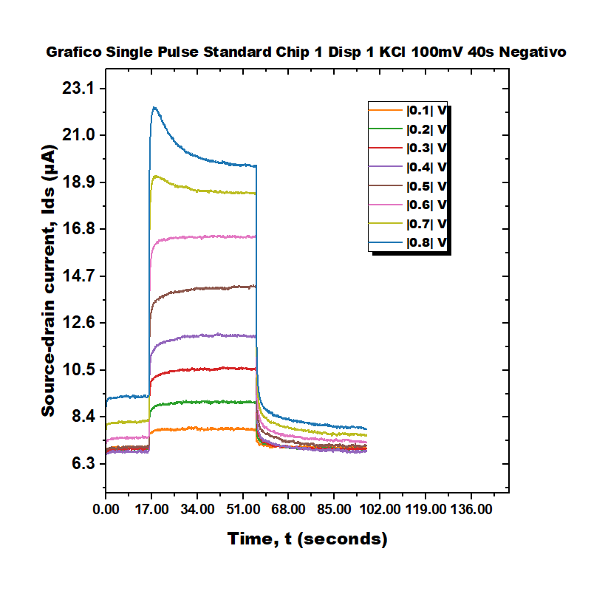
Single Pulse Standard Chip 1 Disp 1 KCl 100mV

Slide 4
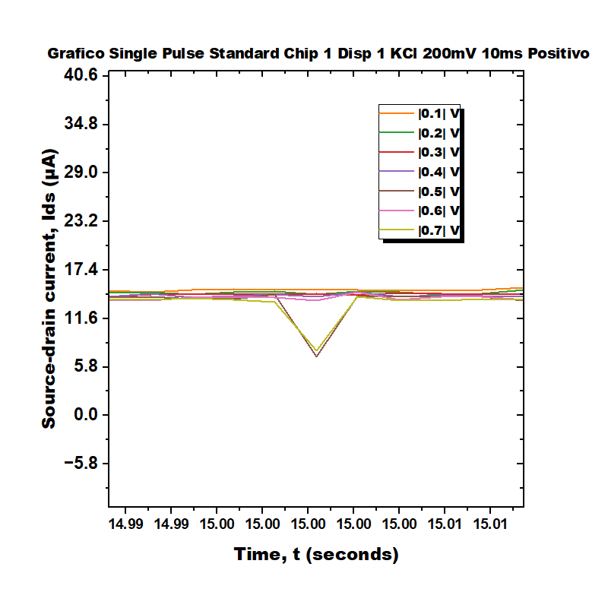
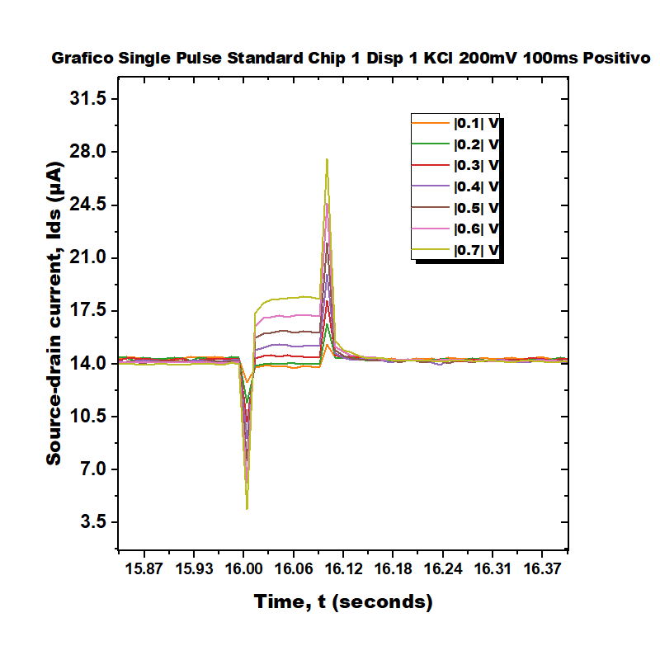
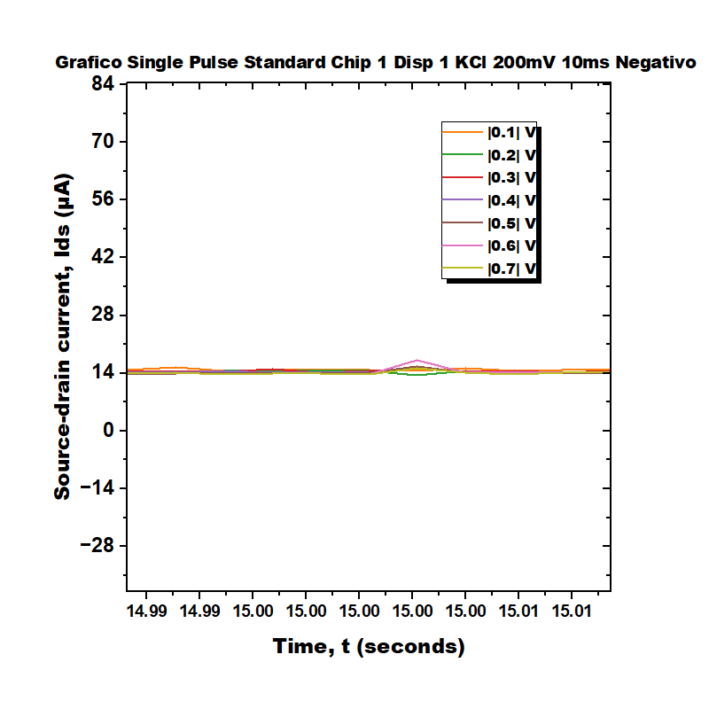
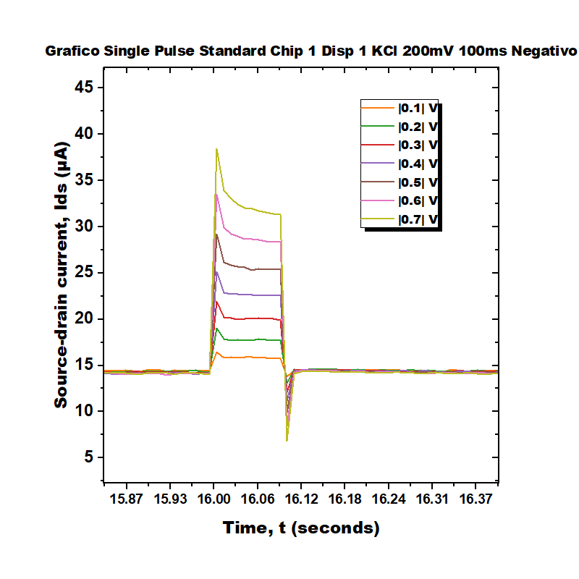
Single Pulse Standard Chip 1 Disp 1 KCl 200mV

Slide 5
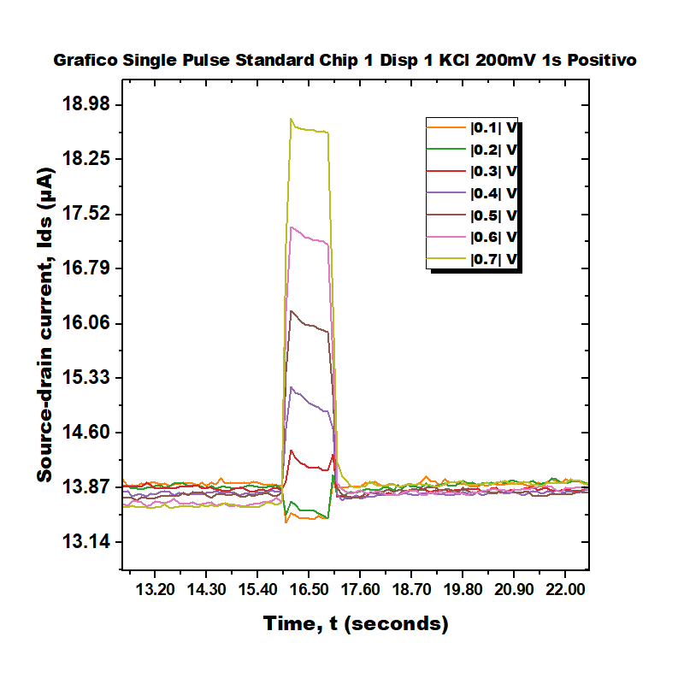
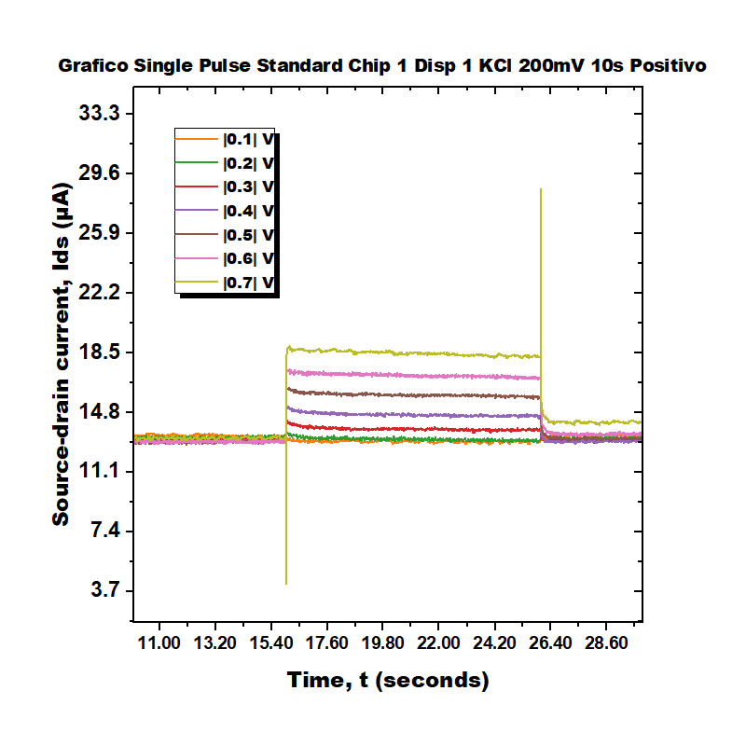
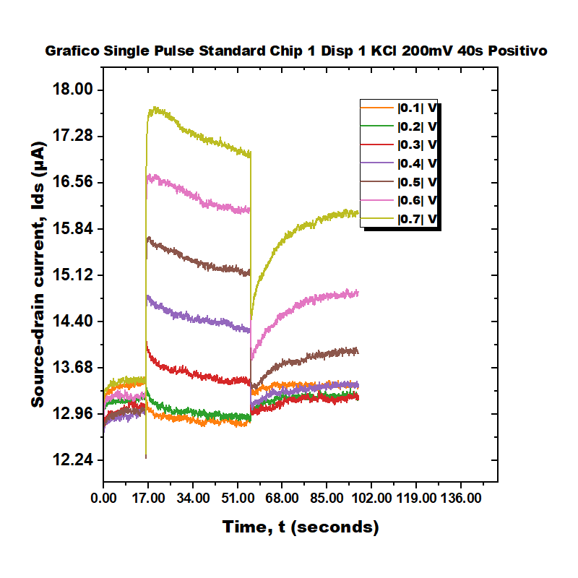
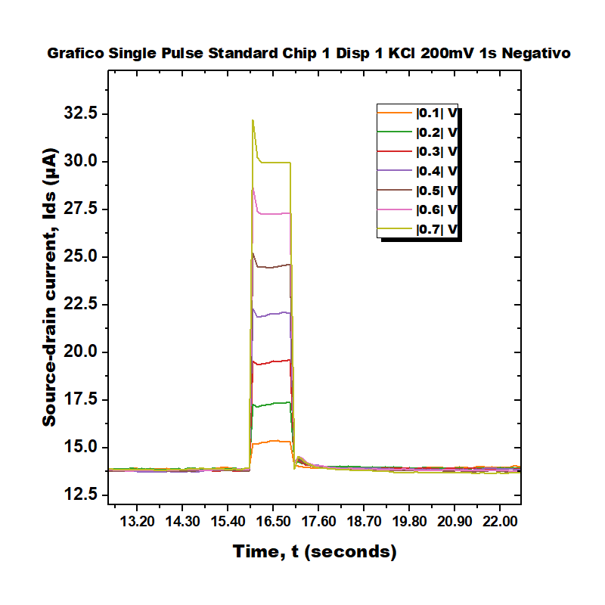
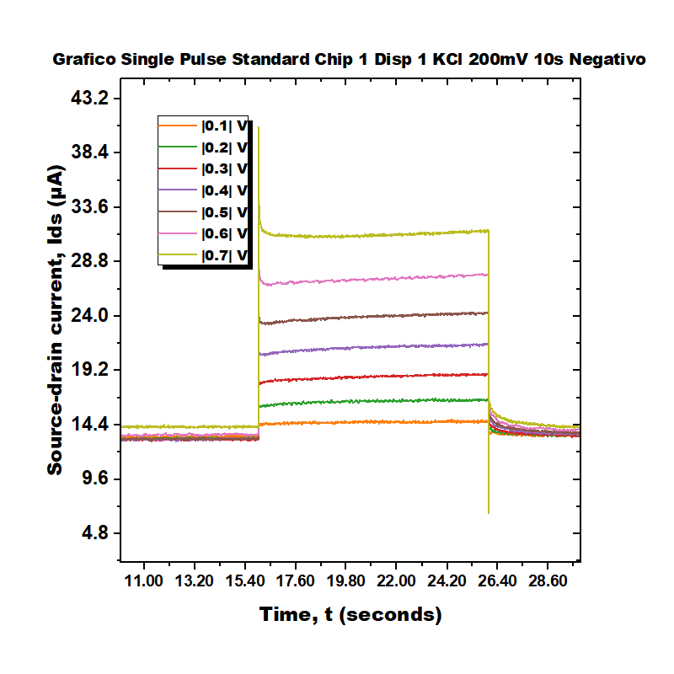
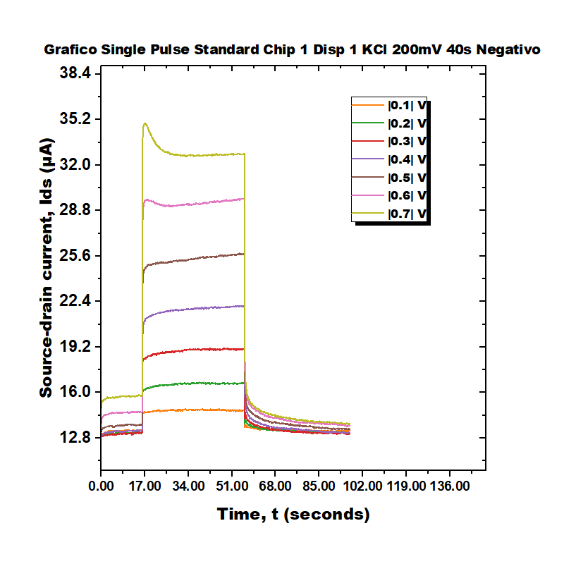
Single Pulse Standard Chip 1 Disp 1 KCl 200mV

Slide 6
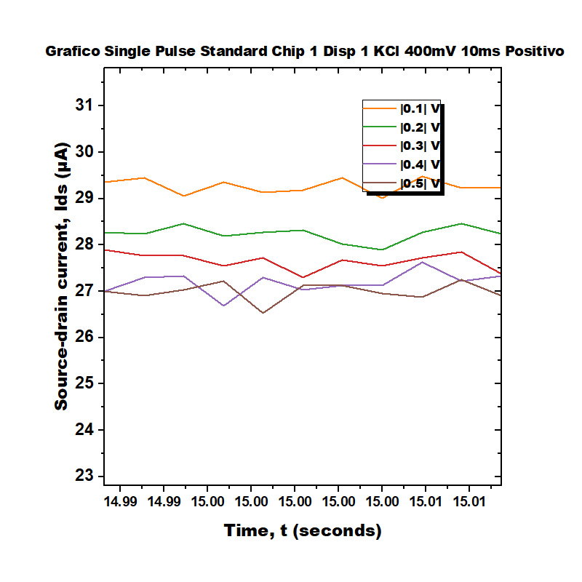
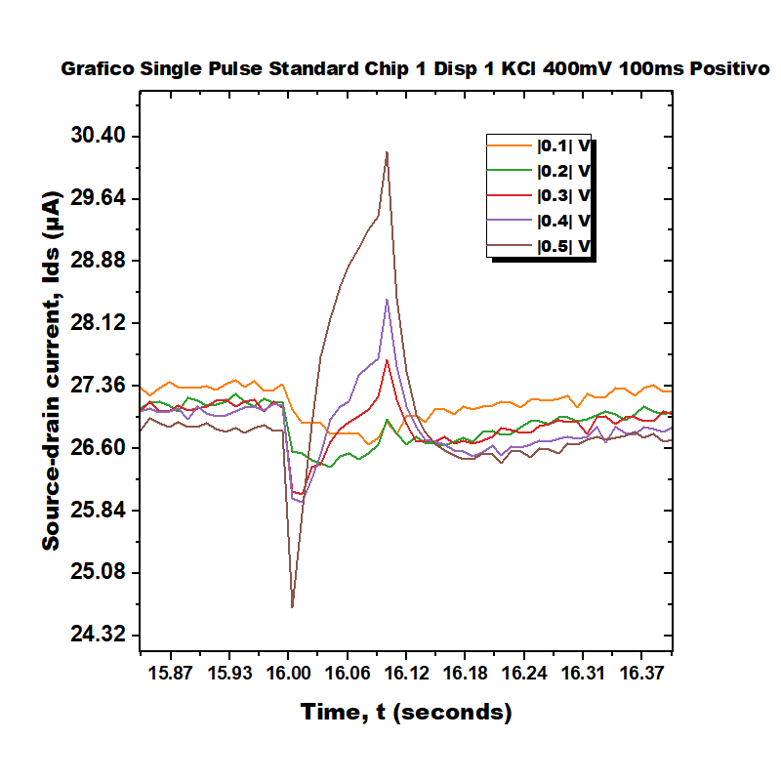
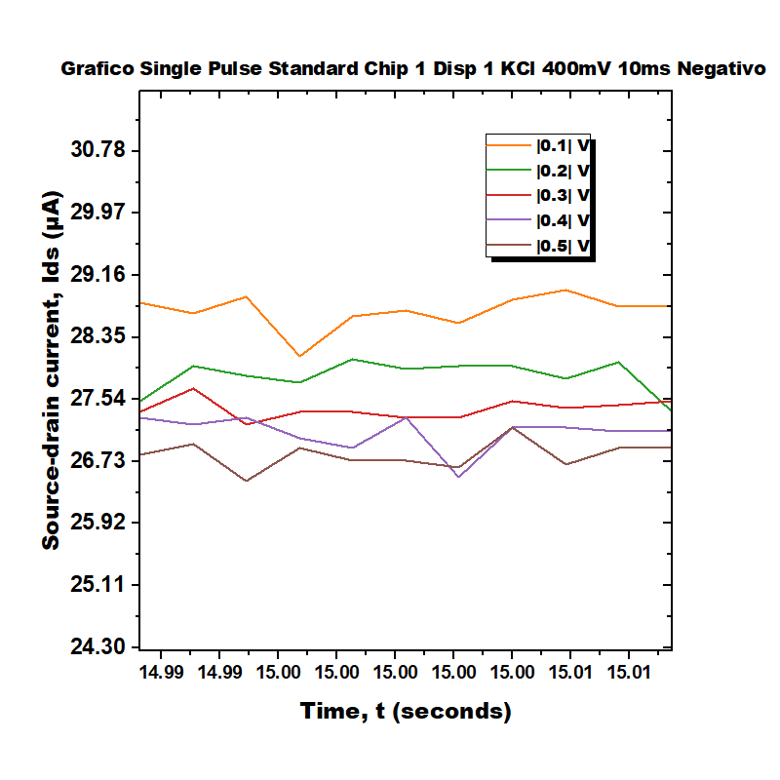
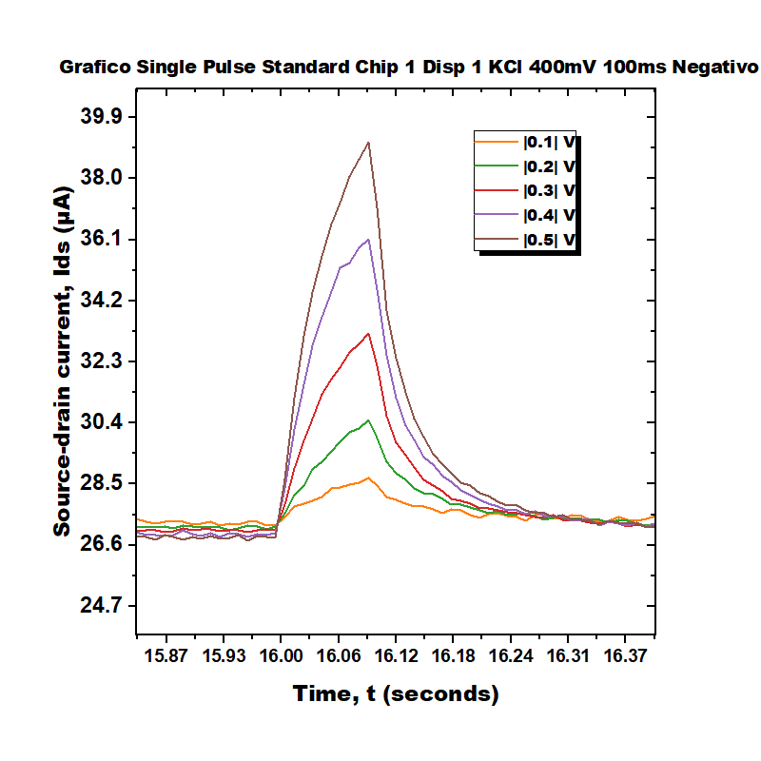
Single Pulse Standard Chip 1 Disp 1 KCl 400mV

Slide 7
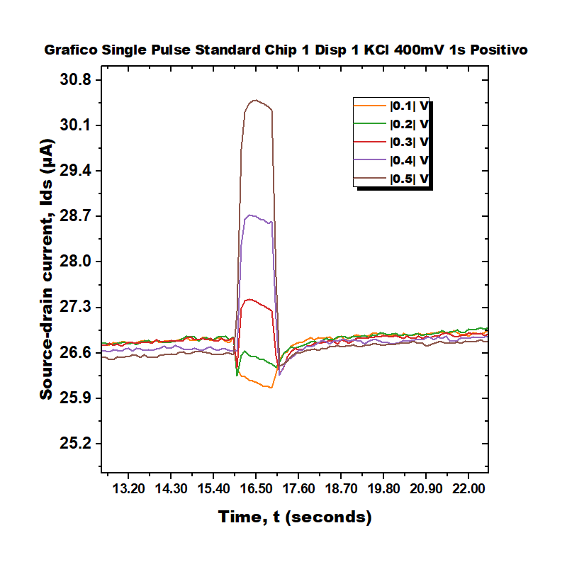
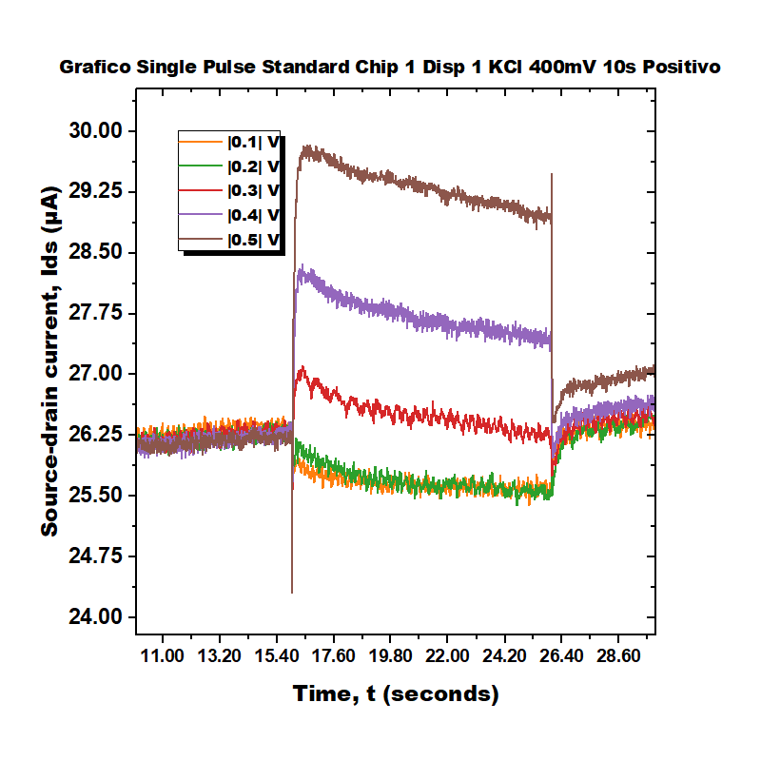
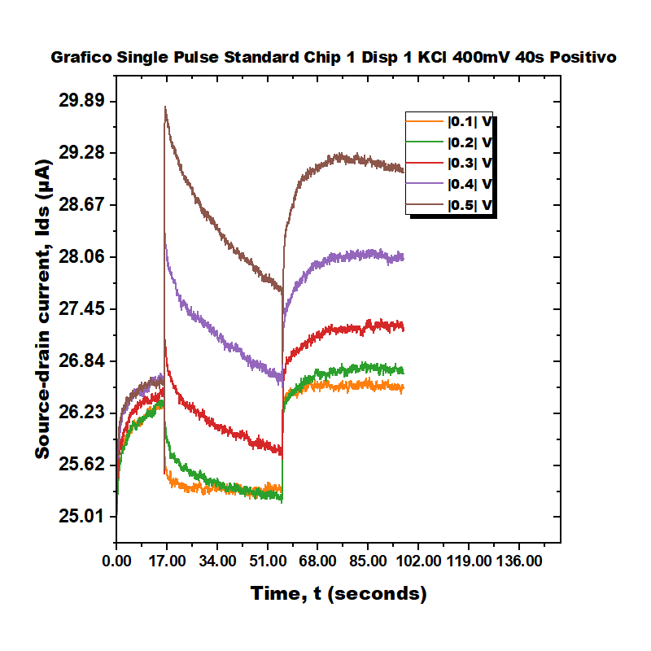
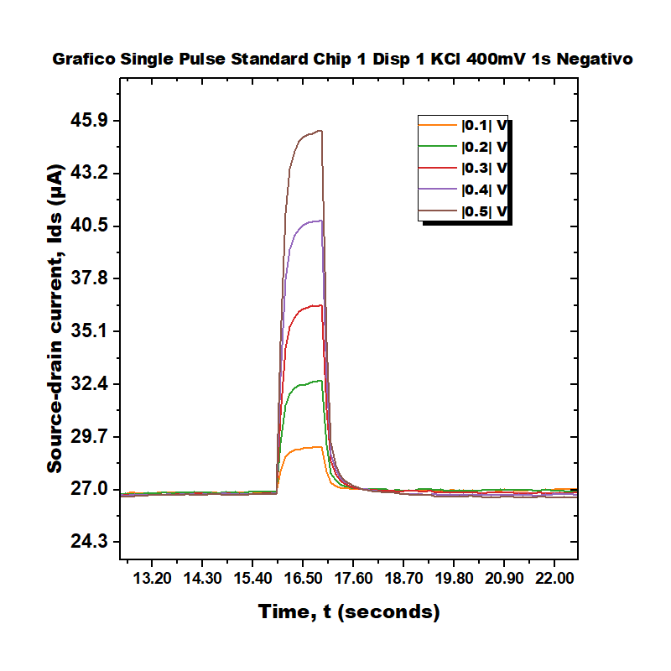
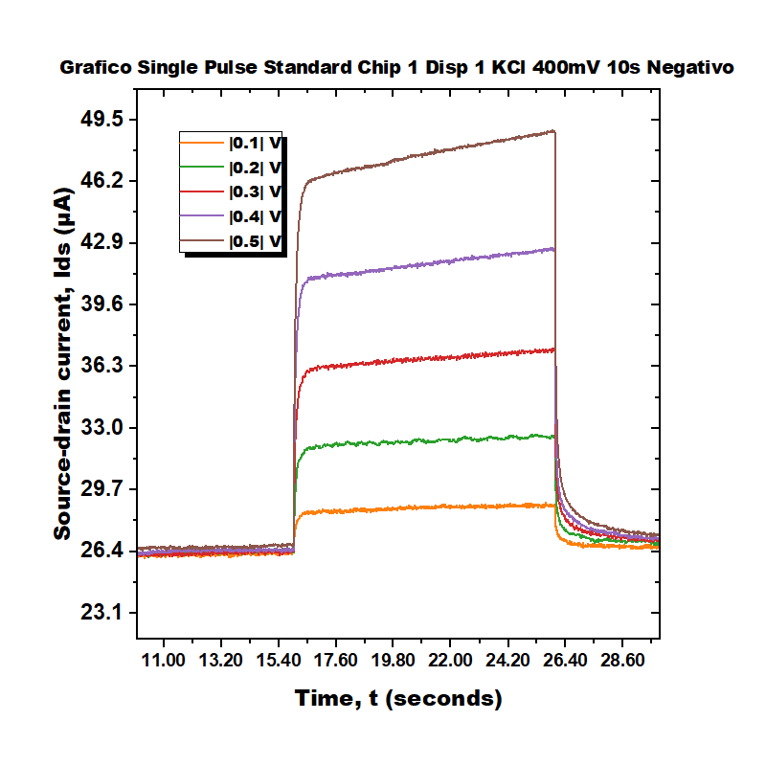
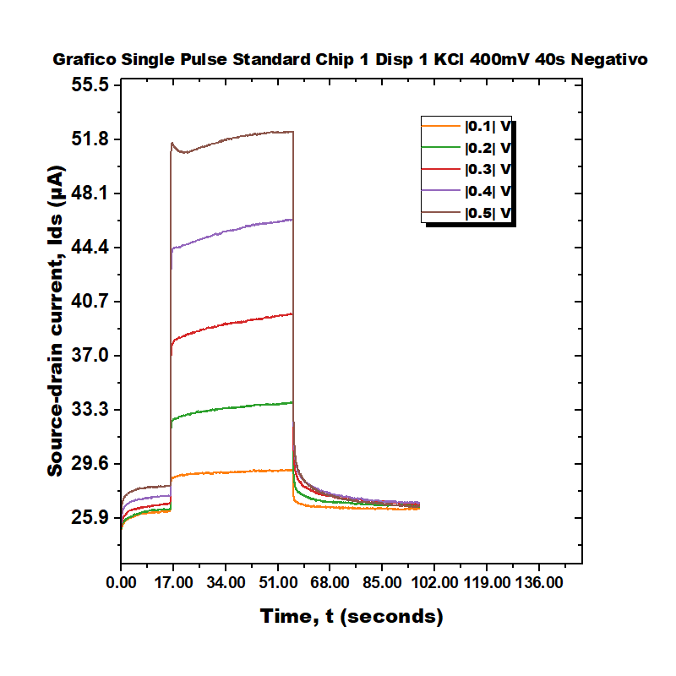
Single Pulse Standard Chip 1 Disp 1 KCl 400mV

Slide 8
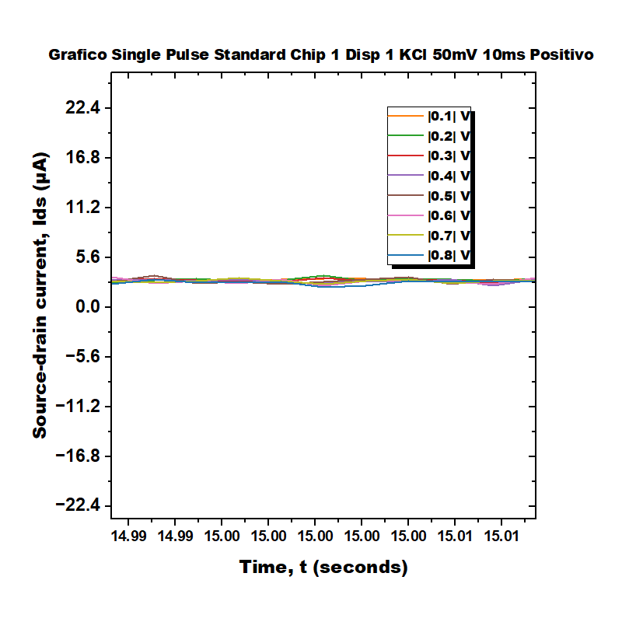
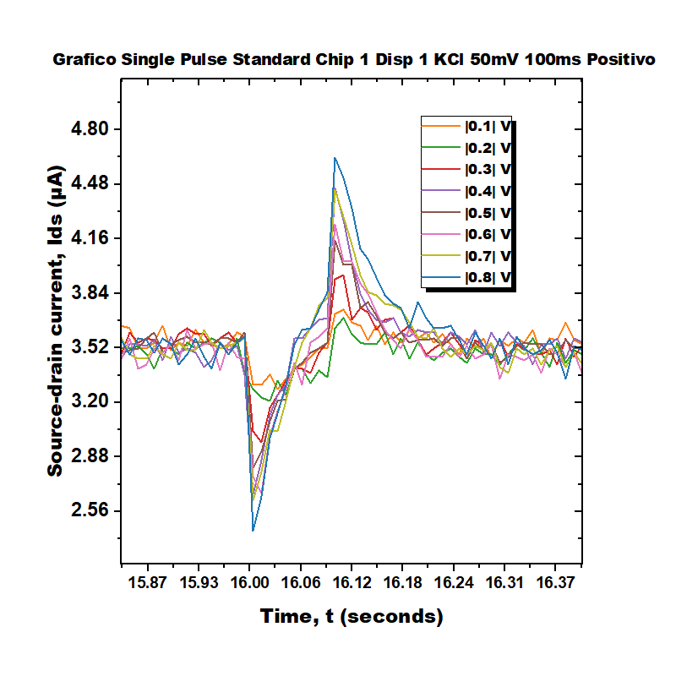
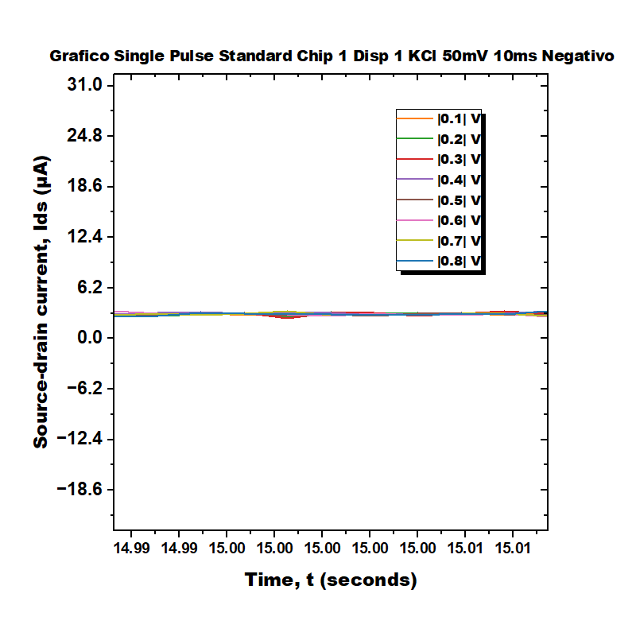
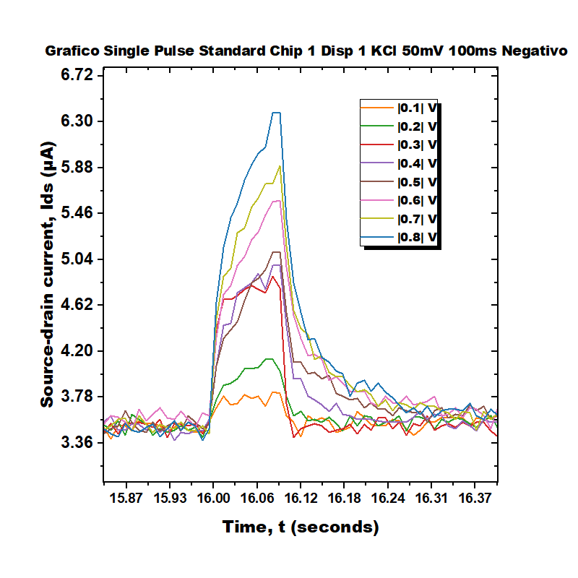
Single Pulse Standard Chip 1 Disp 1 KCl 50mV

Slide 9
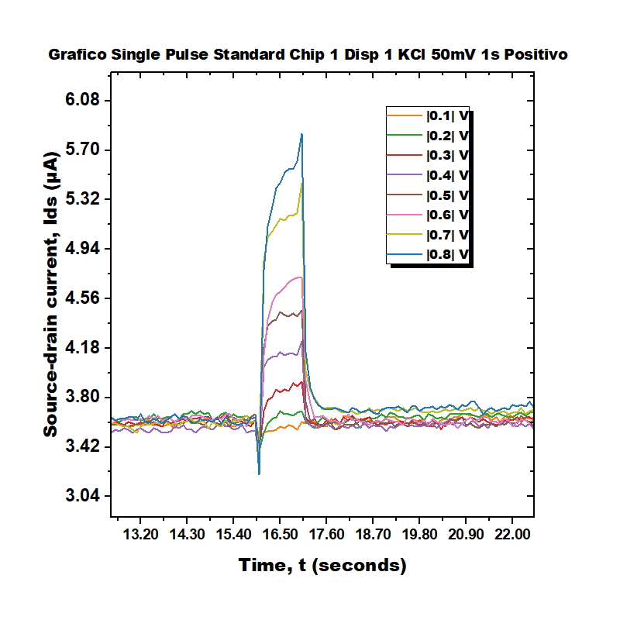
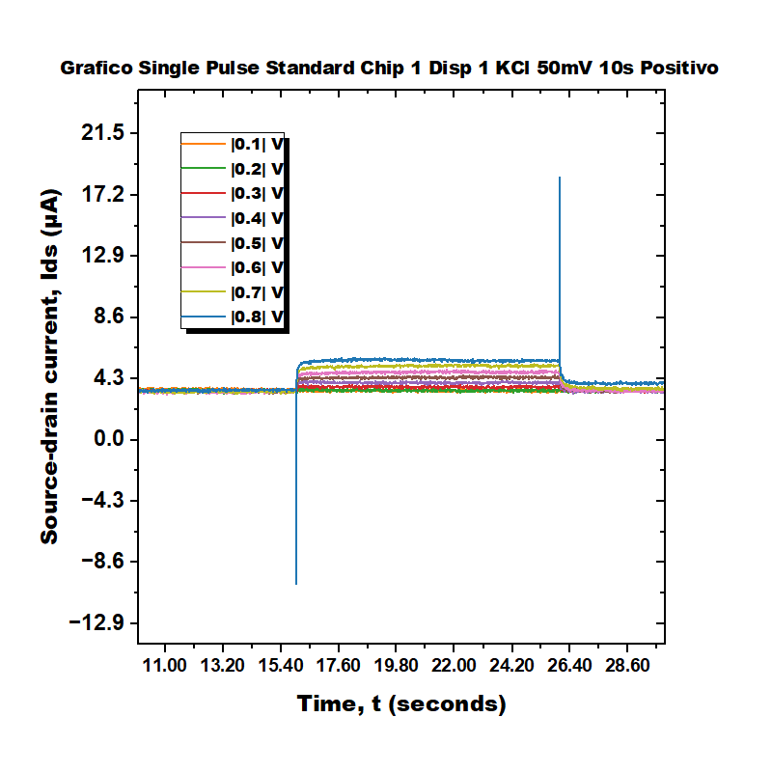
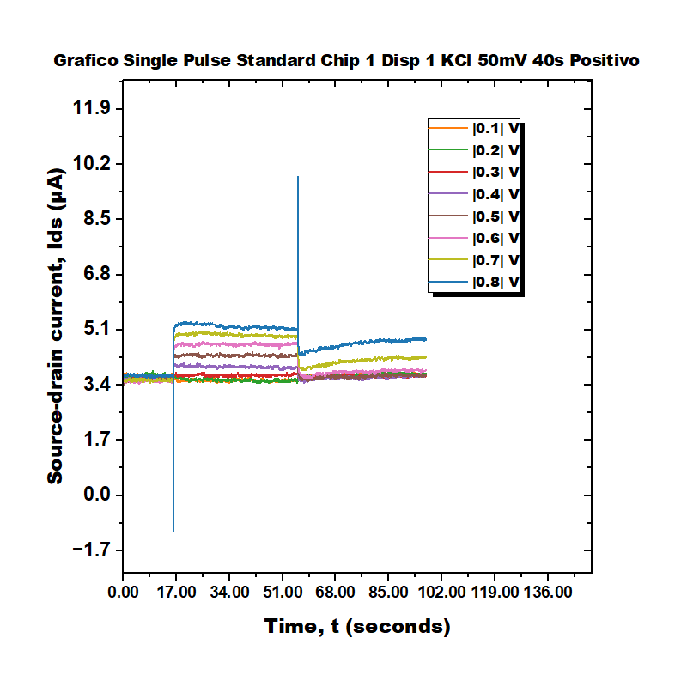
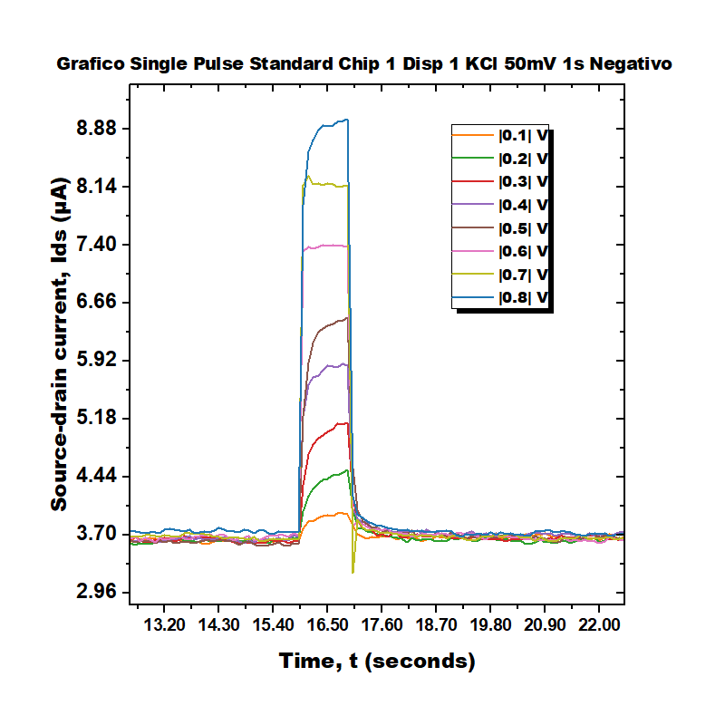
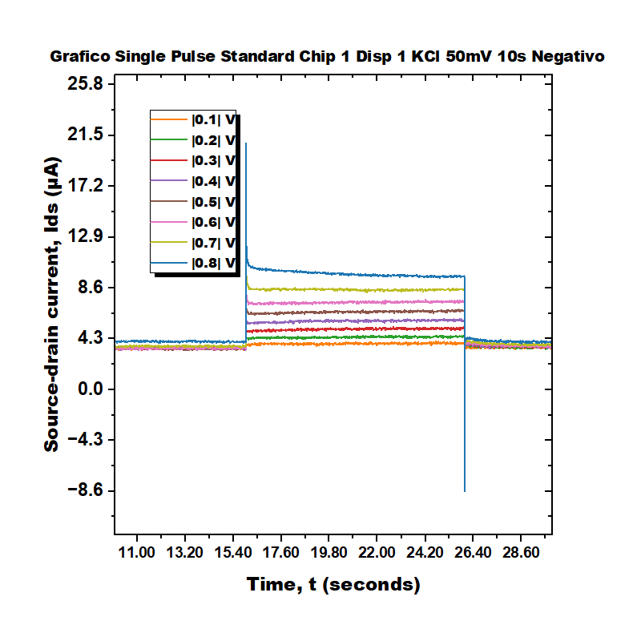
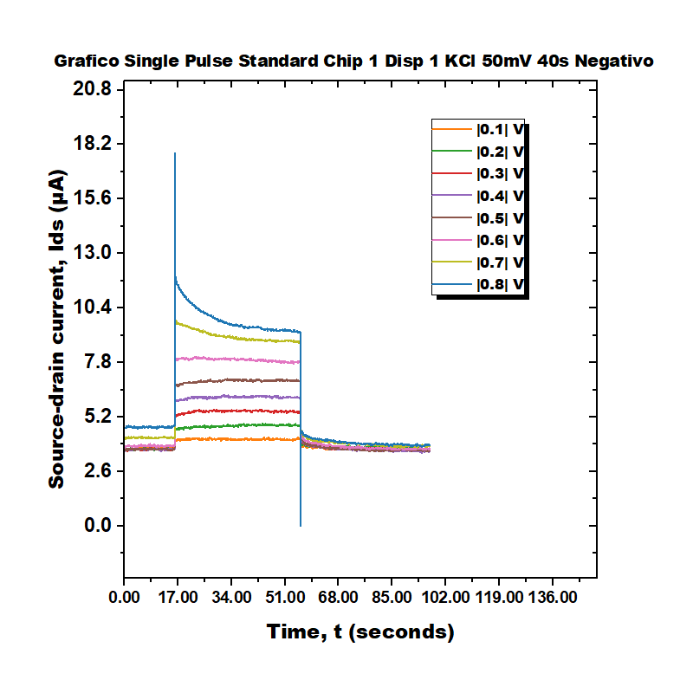
Single Pulse Standard Chip 1 Disp 1 KCl 50mV

Slide 10
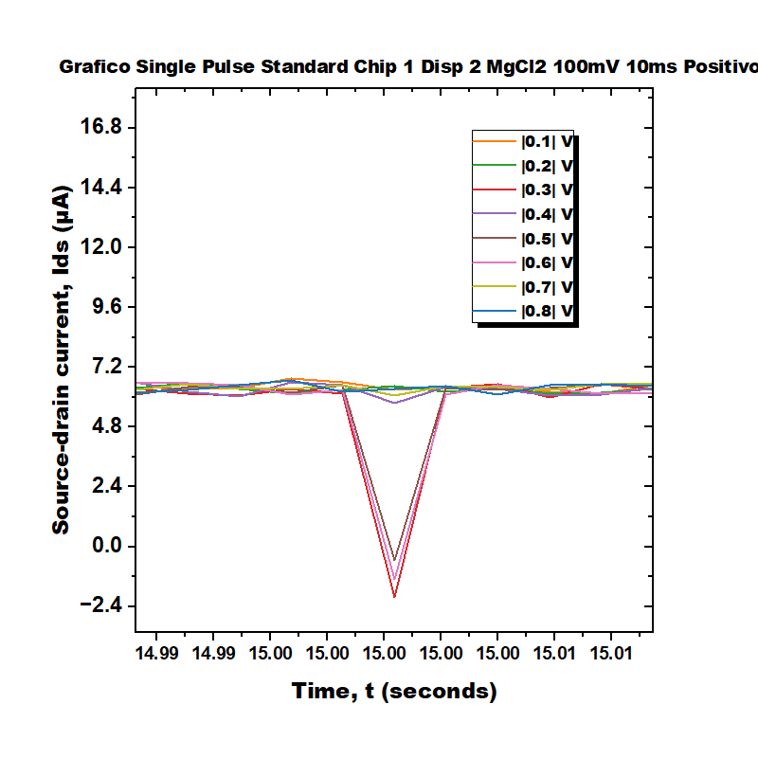
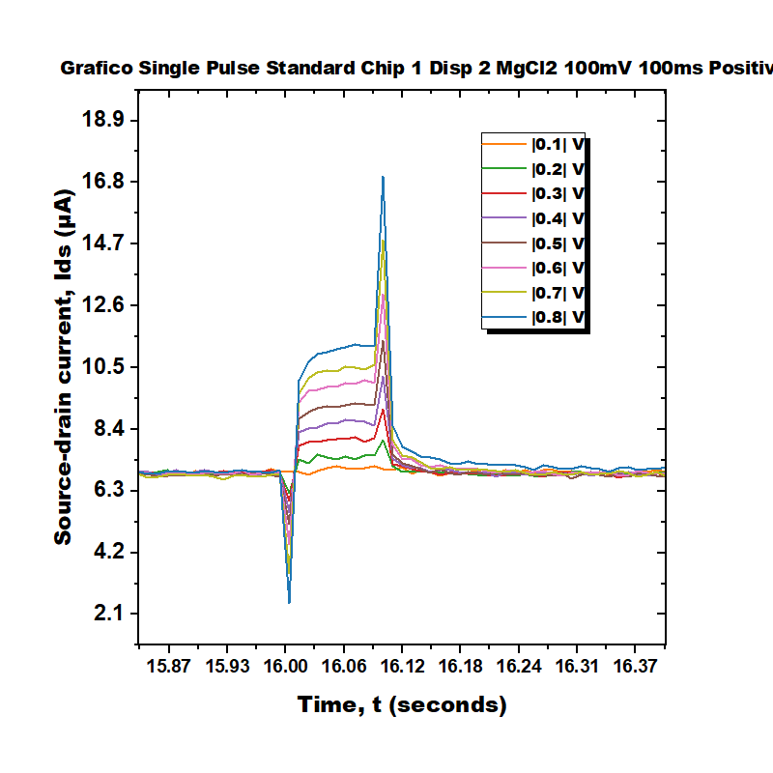
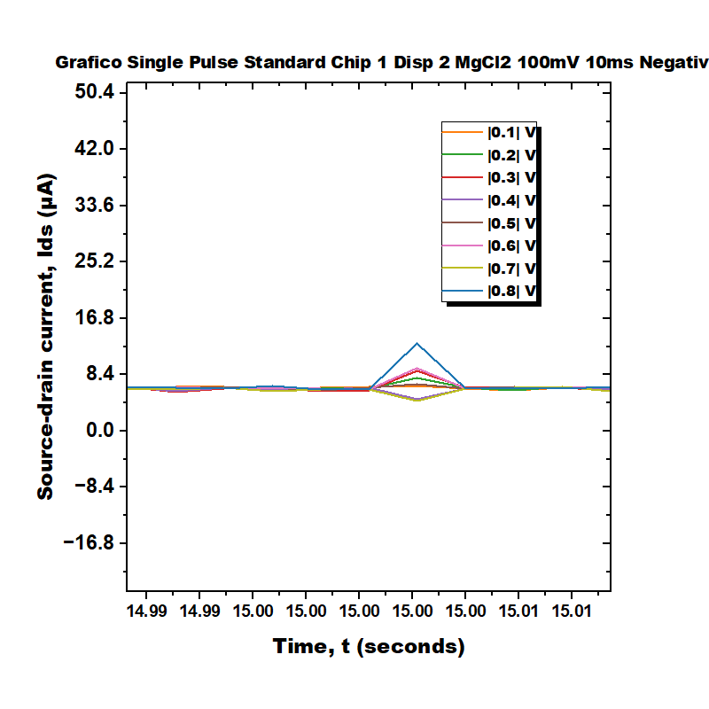
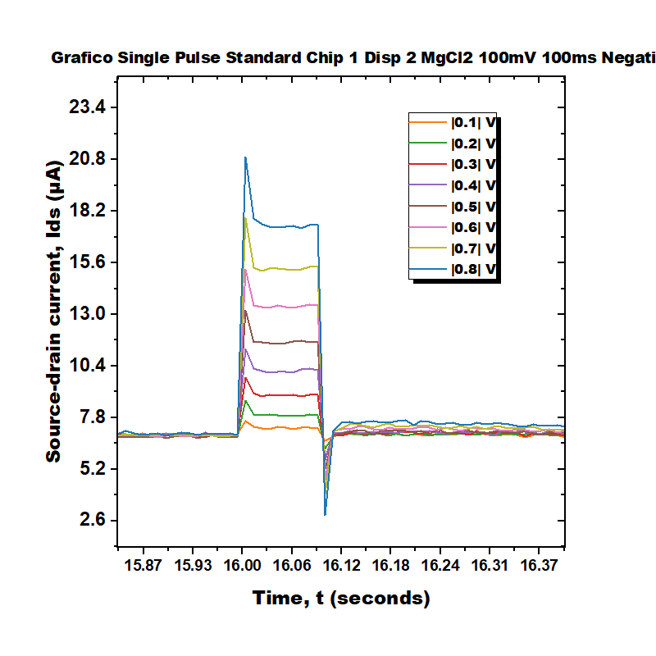
Single Pulse Standard Chip 1 Disp 2 MgCl2 100mV

Slide 11
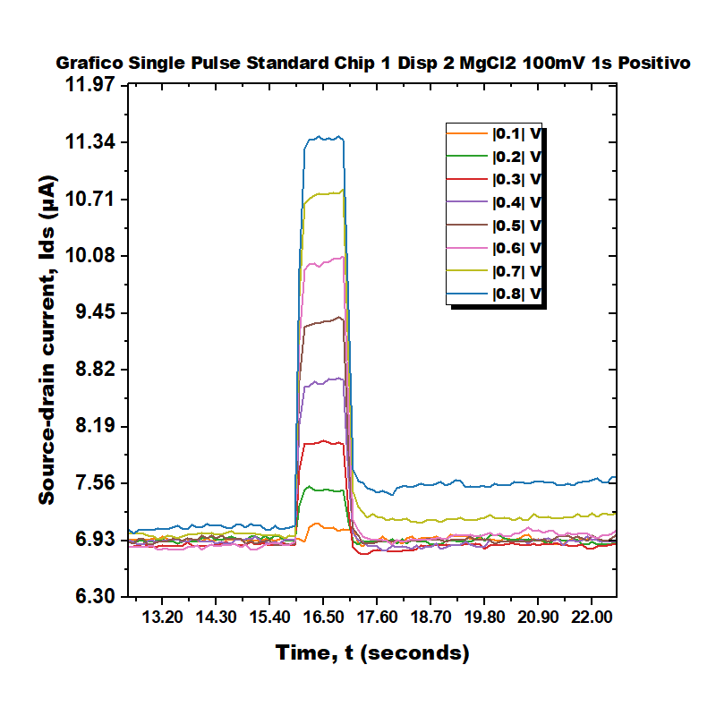
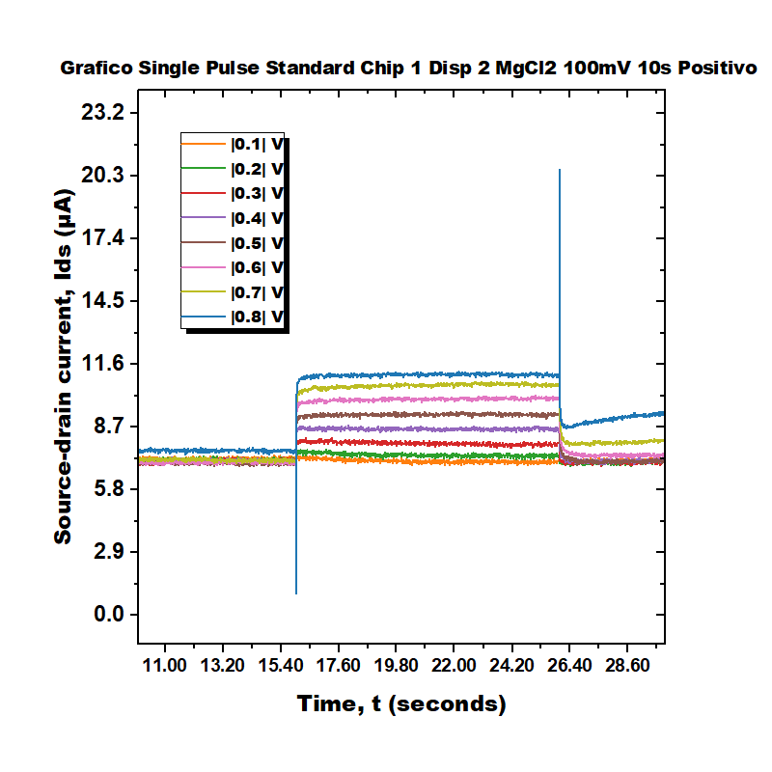
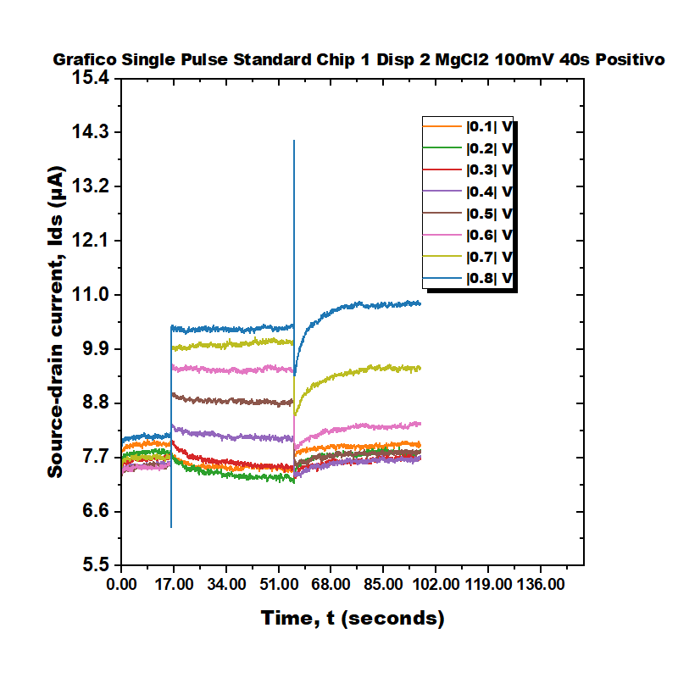
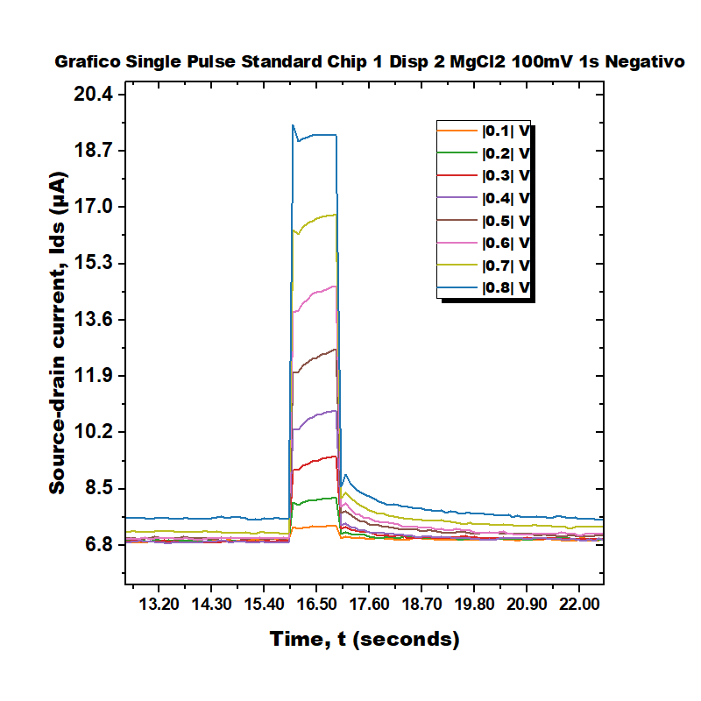
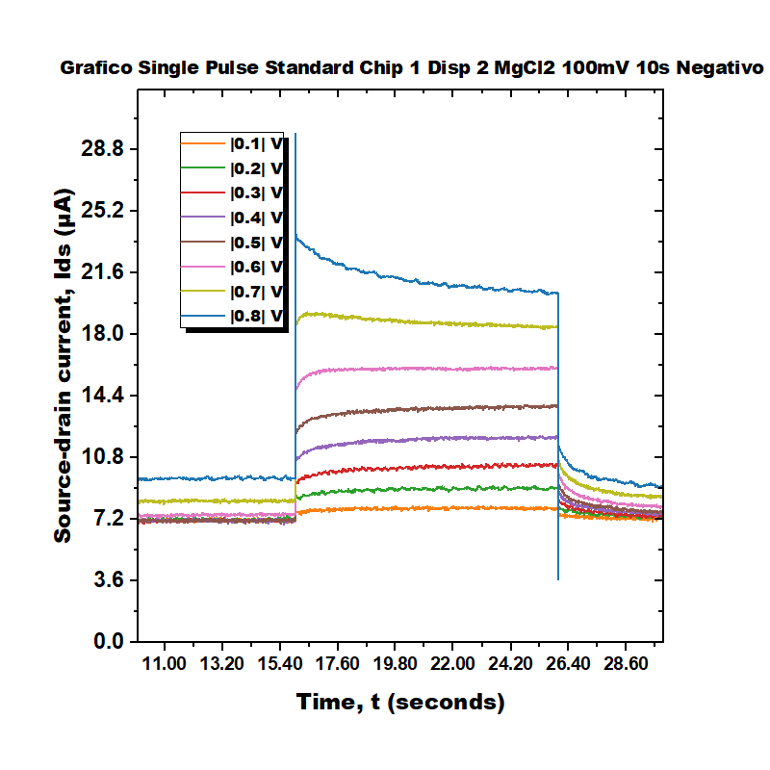
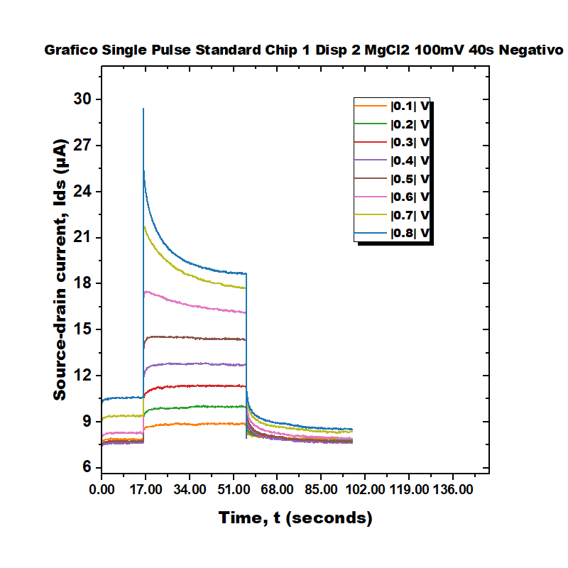
Single Pulse Standard Chip 1 Disp 2 MgCl2 100mV

Slide 12




Single Pulse Standard Chip 1 Disp 2 MgCl2 200mV

Slide 13






Single Pulse Standard Chip 1 Disp 2 MgCl2 200mV

Slide 14




Single Pulse Standard Chip 1 Disp 2 MgCl2 400mV

Slide 15






Single Pulse Standard Chip 1 Disp 2 MgCl2 400mV

Slide 16




Single Pulse Standard Chip 1 Disp 2 MgCl2 50mV

Slide 17






Single Pulse Standard Chip 1 Disp 2 MgCl2 50mV

Slide 18




Single Pulse Standard Chip 1 Disp 3 MgCl2 100mV

Slide 19






Single Pulse Standard Chip 1 Disp 3 MgCl2 100mV

Slide 20




Single Pulse Standard Chip 1 Disp 3 MgCl2 200mV

Slide 21






Single Pulse Standard Chip 1 Disp 3 MgCl2 200mV

Slide 22




Single Pulse Standard Chip 1 Disp 3 MgCl2 400mV

Slide 23






Single Pulse Standard Chip 1 Disp 3 MgCl2 400mV

Slide 24




Single Pulse Standard Chip 1 Disp 3 MgCl2 50mV

Slide 25






Single Pulse Standard Chip 1 Disp 3 MgCl2 50mV

Slide 26




Single Pulse Standard Chip 2 Disp 1 KCl 100mV

Slide 27






Single Pulse Standard Chip 2 Disp 1 KCl 100mV

Slide 28




Single Pulse Standard Chip 2 Disp 1 KCl 200mV

Slide 29






Single Pulse Standard Chip 2 Disp 1 KCl 200mV

Slide 30




Single Pulse Standard Chip 2 Disp 1 KCl 400mV

Slide 31






Single Pulse Standard Chip 2 Disp 1 KCl 400mV

Slide 32




Single Pulse Standard Chip 2 Disp 1 KCl 50mV

Slide 33






Single Pulse Standard Chip 2 Disp 1 KCl 50mV

Slide 34




Single Pulse Standard Chip 2 Disp 2 MgCl2 100mV

Slide 35






Single Pulse Standard Chip 2 Disp 2 MgCl2 100mV

Slide 36




Single Pulse Standard Chip 2 Disp 2 MgCl2 200mV

Slide 37






Single Pulse Standard Chip 2 Disp 2 MgCl2 200mV

Slide 38




Single Pulse Standard Chip 2 Disp 2 MgCl2 400mV

Slide 39






Single Pulse Standard Chip 2 Disp 2 MgCl2 400mV

Slide 40




Single Pulse Standard Chip 2 Disp 2 MgCl2 50mV

Slide 41






Single Pulse Standard Chip 2 Disp 2 MgCl2 50mV

Slide 42




Single Pulse Standard Chip 2 Disp 3 KCl 100mV

Slide 43






Single Pulse Standard Chip 2 Disp 3 KCl 100mV

Slide 44




Single Pulse Standard Chip 2 Disp 3 KCl 200mV

Slide 45






Single Pulse Standard Chip 2 Disp 3 KCl 200mV

Slide 46




Single Pulse Standard Chip 2 Disp 3 KCl 400mV

Slide 47






Single Pulse Standard Chip 2 Disp 3 KCl 400mV

Slide 48




Single Pulse Standard Chip 2 Disp 3 KCl 50mV

Slide 49






Single Pulse Standard Chip 2 Disp 3 KCl 50mV

